Slide 1
Cache Performance Analysis under Multi-parameters using SimpleScalar Simulator
Guided By :-
Mr. Abhijit Kumar
Presented By :-
Himanshu Sati 09210402709
Saurabh Tandan 09910402709
Arunit Gupta 09810402709
Sandeep Kumar 09110402709

Slide 2
Project Outline
To analyze L1 and L2 cache performance using L1 cache parameters
Cache Size: Larger the Cache size, better will be the performance. Also, increasing the cache size would be expensive.
Cache block size: Increasing the block size increases spatial locality and thereby reducing the miss rate. But larger blocks cause larger transfer times.

Slide 3
Project Outline (contd…)
Associativity: Increasing the associativity decreases the miss rate by reducing conflict misses. Also, increasing the associativity further increases hit time and miss penalty due to increased complexity.

Slide 4
SimpleScalar Toolset
Four main simulators
sim-fast: Functional simulator
sim-safe: sim-fast with correct allignment
sim-cache: cache simulator
sim-outorder: simulator that supports out of order execution
sim-cache is used like this.
$ ./sim-cache -cache:dl1 dl1:2:8:2:l ../binary_file

Slide 5
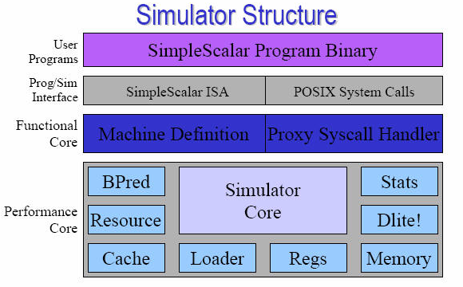
SimpleScalar Architecture

Slide 6
L1 performance analysis on sample programs
Sum of two-dimensional array elements by row-wise accessing
void main(void)
{
int a[4][8]={{1,2,3,4,5,6,7,8}, {6,7,8,9,5,6,7,8}, {10,9,8,7,5,6,7,8}, {5,4,3,2,5,6,7,8}};
int i, j, sum = 0;
for (i = 0; i < 4; i++)
for (j = 0; j < 8; j++)
sum += a[i][j];
}

Slide 7
L1 performance analysis (contd…)
$ bin/sslittle-na-sstrix-gcc -o sum_rowwise sum_rowwise.c
$ ./sim-cache -cache:dl1 dl1:2:8:2:l ../sum_rowwise
sim-cache:
cache statistics for Data L1 cache having number of sets=2, number of lines (Associativity)=2 and Block size=8 bytes
Least Recently Used (LRU) Replacement policy is applied
Total size of initialized array=4*8*4= 128 bytes
Total Cache size=2*8*2= 32 bytes
Cache size<Initialized Array in the memory

Slide 8
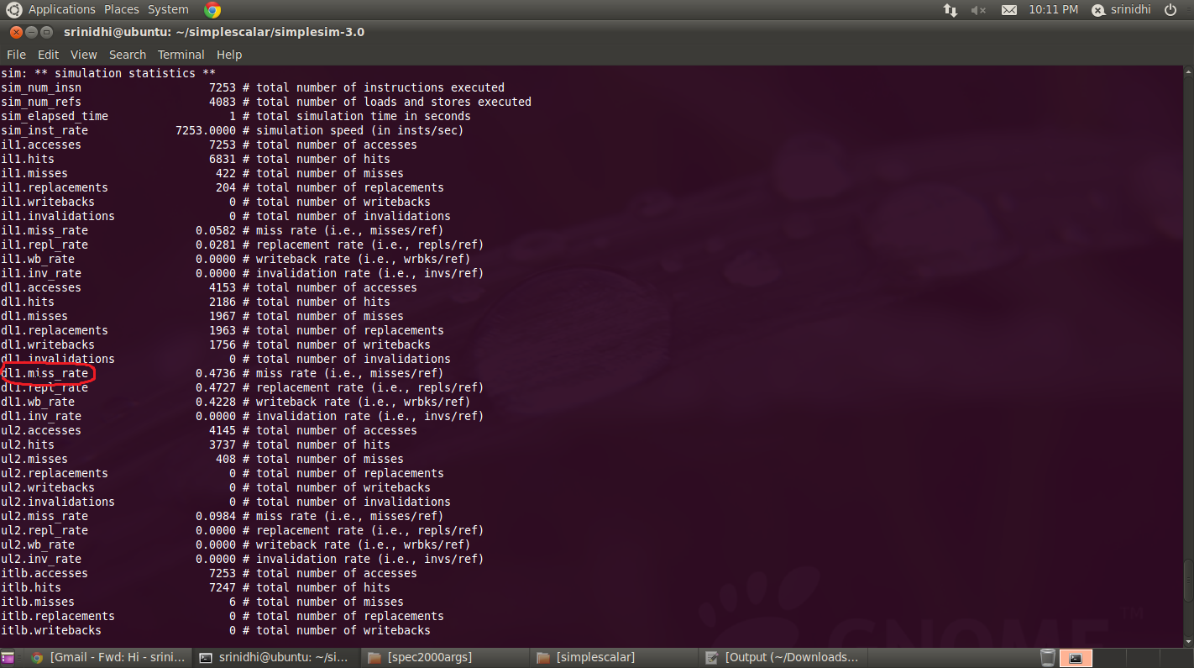
Simulation Statistics

Slide 9
Additional Sample programs
Column-wise Sum
Row-wise Sum but step=2
Row-wise Sum but step=3

Slide 10
Methodology
$ ../simplesim-3.0/sim-cache ../spec2000binaries/gcc00.peak.ev6 –cache:dl1 dl1:<no_sets>:<block size>:<associativity>:<replacement policy>
sim-cache:
cache statistics for gcc application for L1 data cache.
l stands for Least Recently Used (LRU) Replacement policy.

Slide 11
Simulation Results
Simulations were run on SPEC2000 binaries.
Applications used to analyze L1 and L2 cache performance are gcc (compiler) and gzip (compress )
L2 cache size was fixed at 256kB
L1 cache size was varied by varying the number of sets, block size and associativity.
The metric used to analyze the performance of L1 and L2 is miss rate.

Slide 12
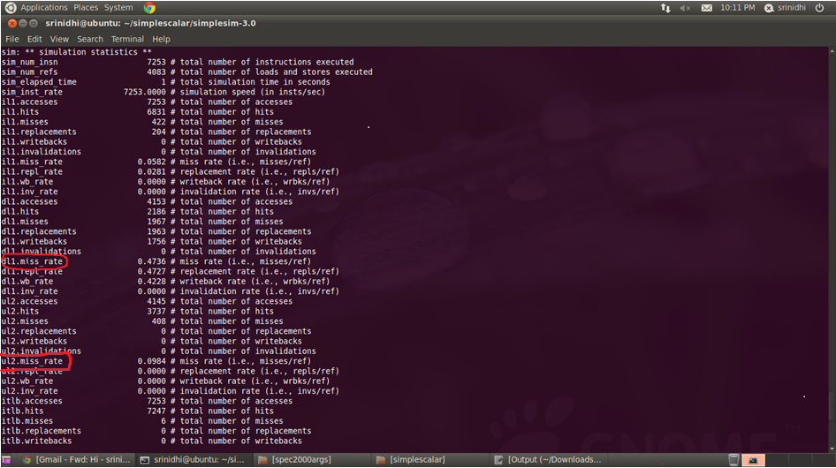
Performance metric

Slide 13
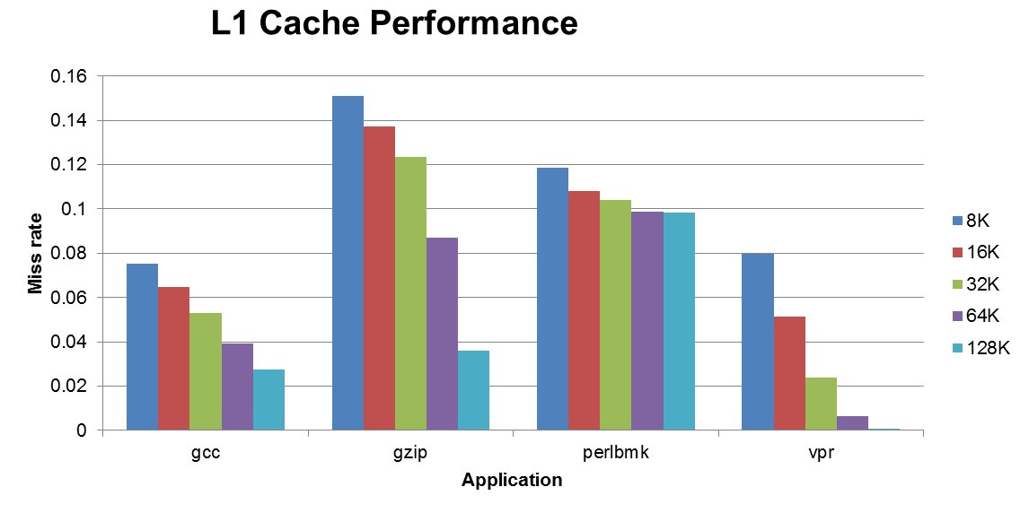
L1 cache performance – no of sets

Slide 14
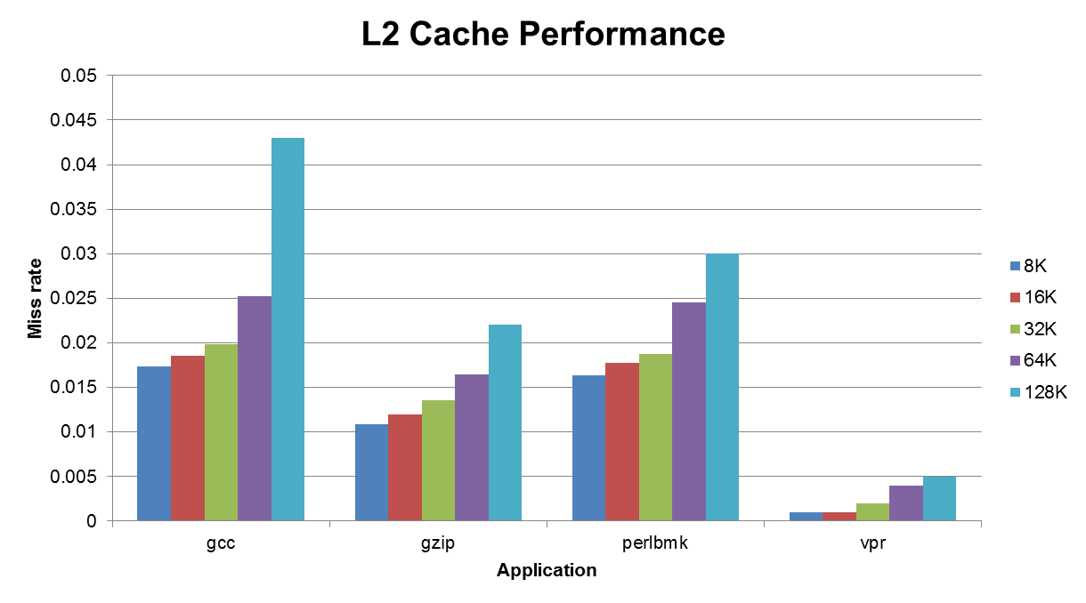
L2 Cache Performance – no of sets

Slide 15
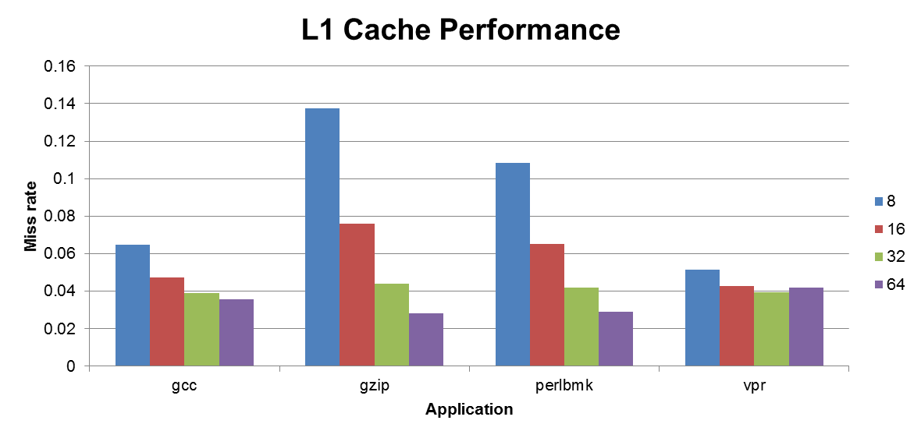
L1 Cache Performance – Block size
Block size was varied from 8 bytes/block to 64bytes with L1 cache size kept constant at 16kB and associativity at 2. Initial number of sets is1024.

Slide 16
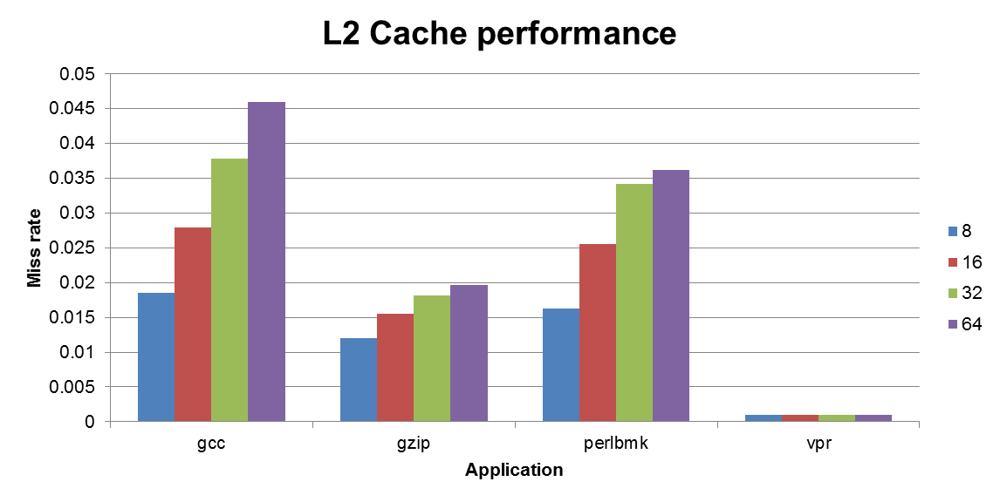
L2 Cache Performance – Block size

Slide 17
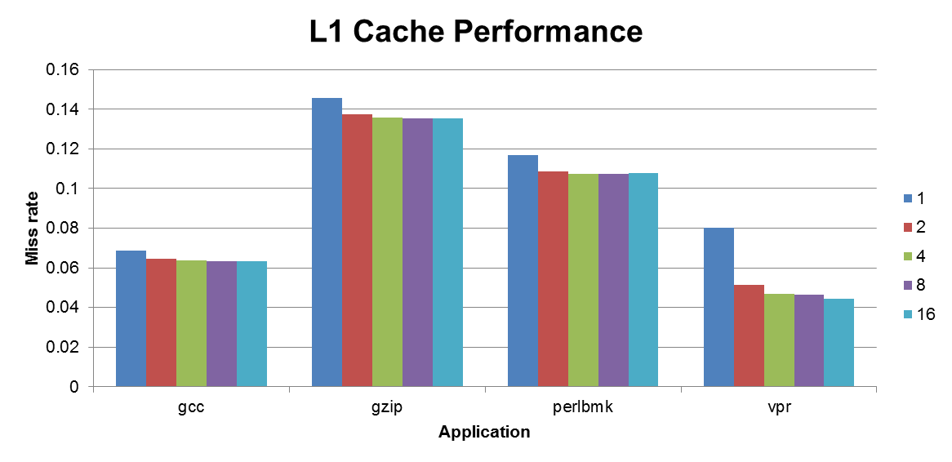
L1 Cache Performance -Associativity
The number of lines per set was varied from 1 to 16 with L1 cache size kept constant at 16kB and block size at 8. Initial number of sets is 2048.

Slide 18
Conclusion
Trade off between L1 cache parameters and cost/transfer time/miss penalty.
L2 miss rate is also dependent on L1 cache size
L1 cache size must be atleast 4 to 8 times lesser than L2 cache size for optimal performance.

Slide 19
References
[1] Haifeng Ma, Xin Yue and Jingfeng Song, “Cache Performance Simulation and Analysis under Multi-parameters”, 2010 International Conference on Machine Vision and Human-machine Interface (MVHI), pp. 37-40, 2010.
[2] Randal E. Bryant, David R. O’Hallaron, “Computer Systems A Programmer’s Perspective”, pp. 298-321, November 2001.
[3] Waseem Ahmad, Enrico Ng, “A Quantitative/Qualitative Study for Optimal Parameter Selection of a Superscalar Processor using SimpleScalar”, Computer Sciences Technical Report, 2004.
[4] AJ KleinOsowski, John Flynn, Nancy Meares, and David J. Lilja, “Adapting the SPEC 2000 Benchmark Suite for Simulation-Based Computer Architecture Research”, In Proceedings of the International Conference on Computer Design, 2000.

Slide 20


